Slide 1

WATERSAFE
The Place to Go for Water Quality Information in Martin County
Prakriti Biswas
Jennifer Magnus Gent
Elizabeth Lyman
Yuri Perdonati
Grant Roberts

Slide 2
THE NEED
Periodic Water Quality Problems in the St. Lucie River and the Oceans in Marin County
Excess Nutrients Promote Algae Blooms
Algae blooms block sunlight and reduce the oxygen in the water which leads to loss of sea grass and near shore coral reefs, the destruction of oyster beds, and fish kills.
Sea grass and coral reefs are home to young fish, shellfish and other small marine life as well as a food staple for many marine mammals. Oysters help to clean the water, one oyster can purify 50 gallons of water per day.
In competition for the nutrients in the water, the Algae Blooms emit a bacteria that is toxic to the nerves system of other species.

Slide 3
THE NEED
The toxic algae and the bacteria that it produces are very hazardous to the health of humans, animals and marine life.
The human symptoms of contact include stomach and intestinal illness (nausea, upset stomach, diarrhea), Allergic Reactions (respiratory distress, eye irritations, skin rashes), and neurotoxic reactions (limb weakness or numbness, loss of memory, delusions).
Children, Pets, and those with Immune Deficiencies are at greater risk due to their size and compromised immune systems.

Slide 4
WHERE DID THE NUTRIENT POLLUTION COME FROM?

Slide 5
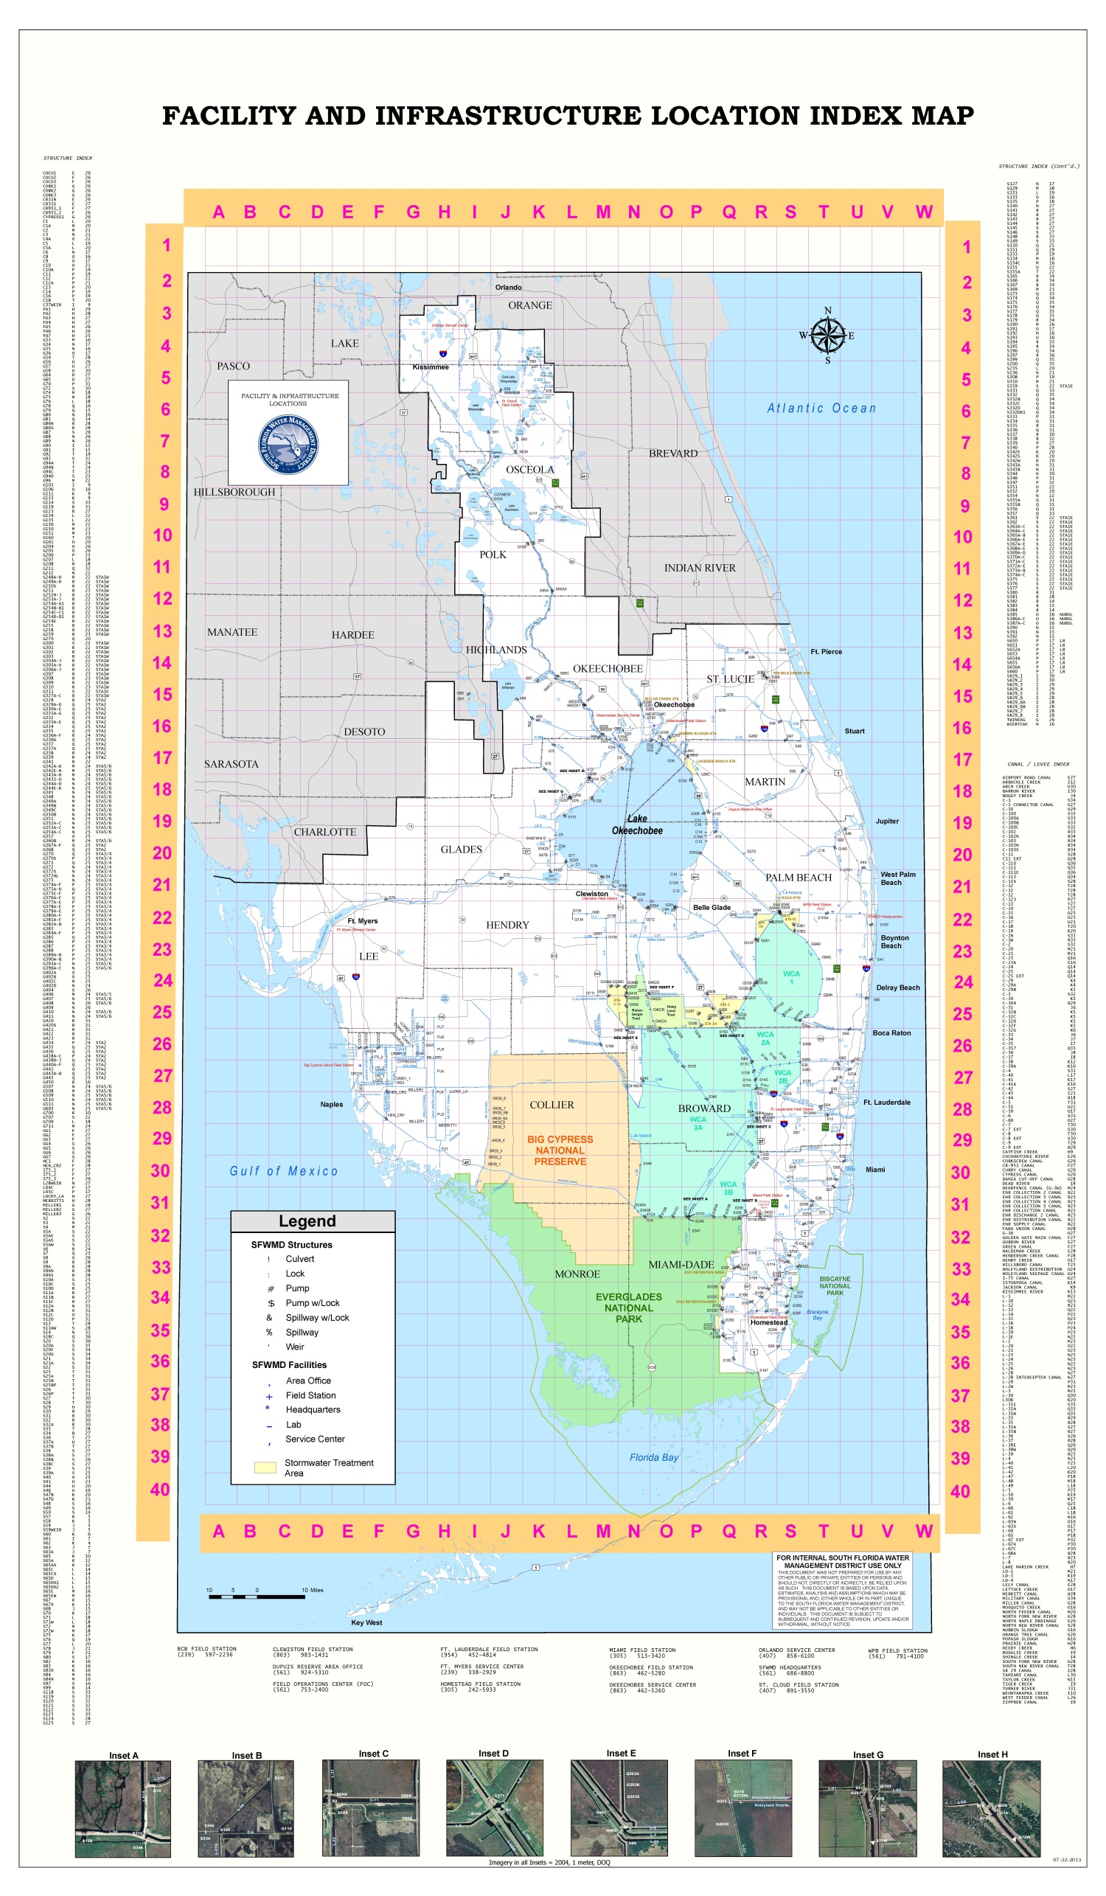

Kissimmee River Basin →
Lake Okeechobee →
St. Lucie Canal →
St. Lucie River→
Inlet →
Surrounding Beaches

Slide 6
Kissimmee River Basin →
Lake Okeechobee →
St. Lucie Canal →
St. Lucie River→
Inlet →
Surrounding Beaches

Slide 7
Kissimmee River Basin →
Lake Okeechobee →
St. Lucie Canal →
St. Lucie River→
Inlet →
Surrounding Beaches

Slide 8
Kissimmee River Basin →
Lake Okeechobee →
St. Lucie Canal →
St. Lucie River→
Inlet →
Surrounding Beaches

Slide 9
Kissimmee River Basin →
Lake Okeechobee →
St. Lucie Canal →
St. Lucie River→
Inlet →
Surrounding Beaches

Slide 10
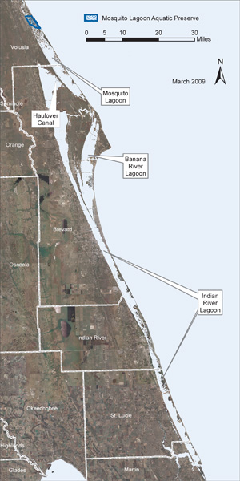
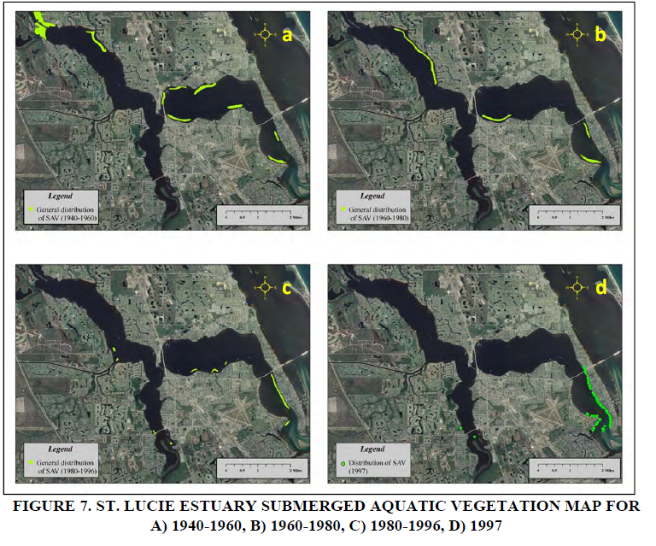
The Indian River Lagoon and the St. Lucie River & Estuary
St. Lucie River

Slide 11
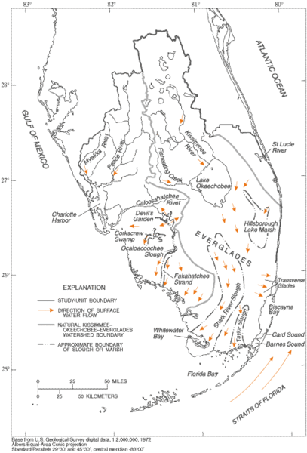
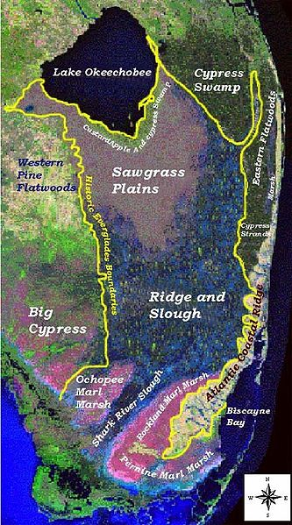
The Everglades

Slide 12
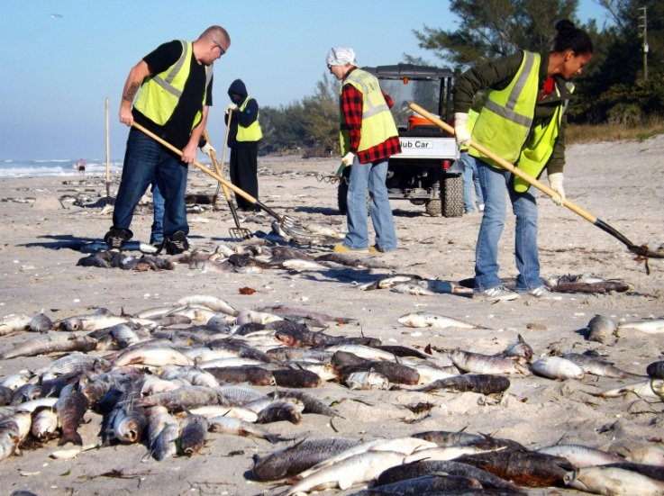
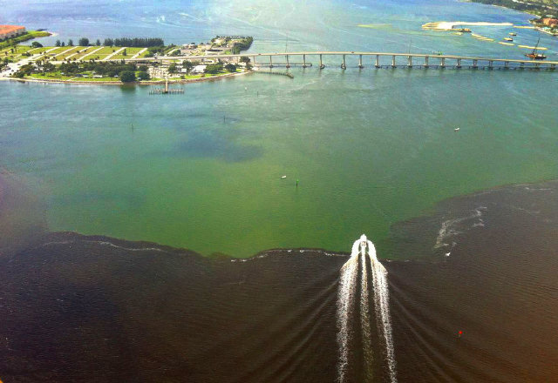
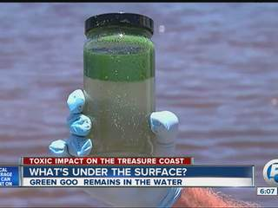
Lake Okeechobee Discharge Effects in the St. Lucie Estuary, River and Indian River Lagoon

Slide 13
PUBLIC NOTIFICATION
Health Department Posts Advisory Warnings at Parks and Boat Ramps
Heath Department’s Website Provides Nutrient Readings and Locations of Advisories
What about People on the go?
Recreational Users
Boaters
Paddle Boarders
Jet Ski Users
Home Owners
Year Round
Seasonal
Businesses
Charter Fishing
Hotels
Restaurants

Slide 14
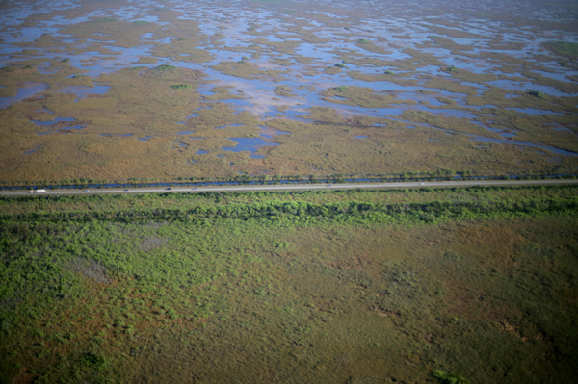
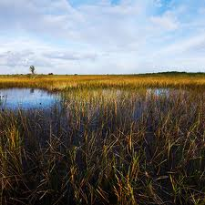
WATER SAFE
The Place to Go for Water Quality Information in Martin County

Slide 15
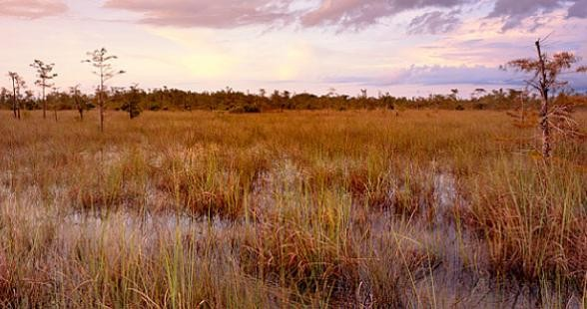
WATER SAFE

